Slide 1
T H E
*ni
F A C T O R

Slide 2


2018
{
"title": "The X factor",
"Speaker": "Bartosz Bielawski, Thorsten Butz",
"StartTime": "2018-04-19 17:15:00",
"Category": "Core",
"ID": 65
}

Slide 3
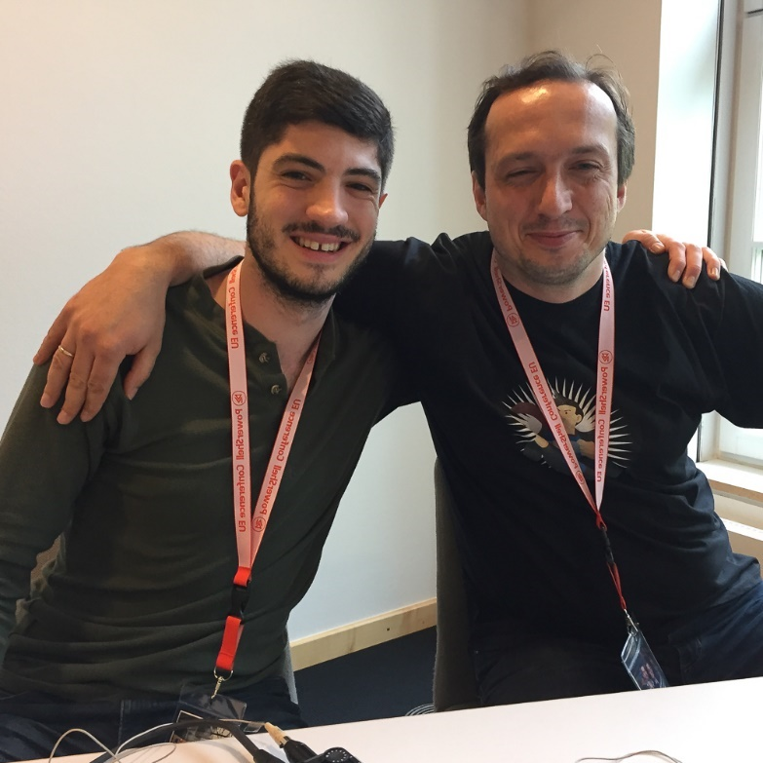
Previously
2015, Essen WPK: OMI, DSC @Linux ...
2015, Essen WPK: OMI, DSC @Linux ...
2017, Hannover Sliding Windows: "Microsoft 3.0" with Joey Aiello http://slidingwindows.de/slw07/

Slide 4
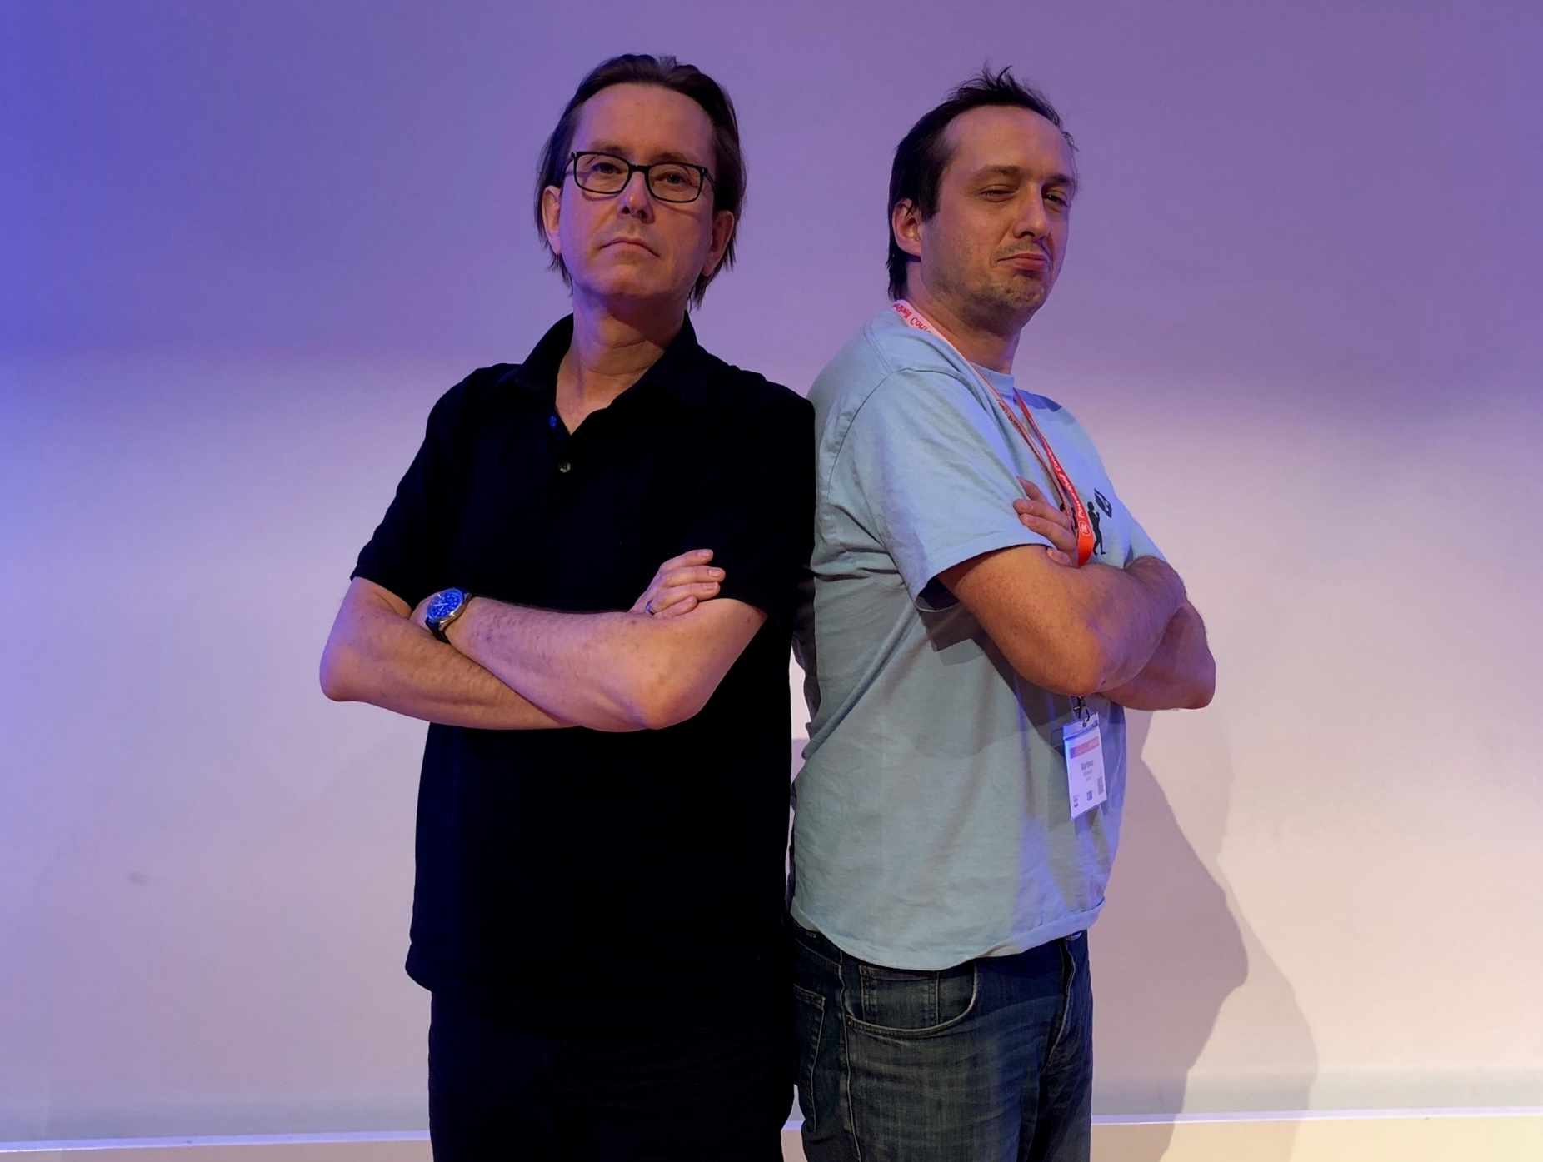
The perfect match?

Slide 5
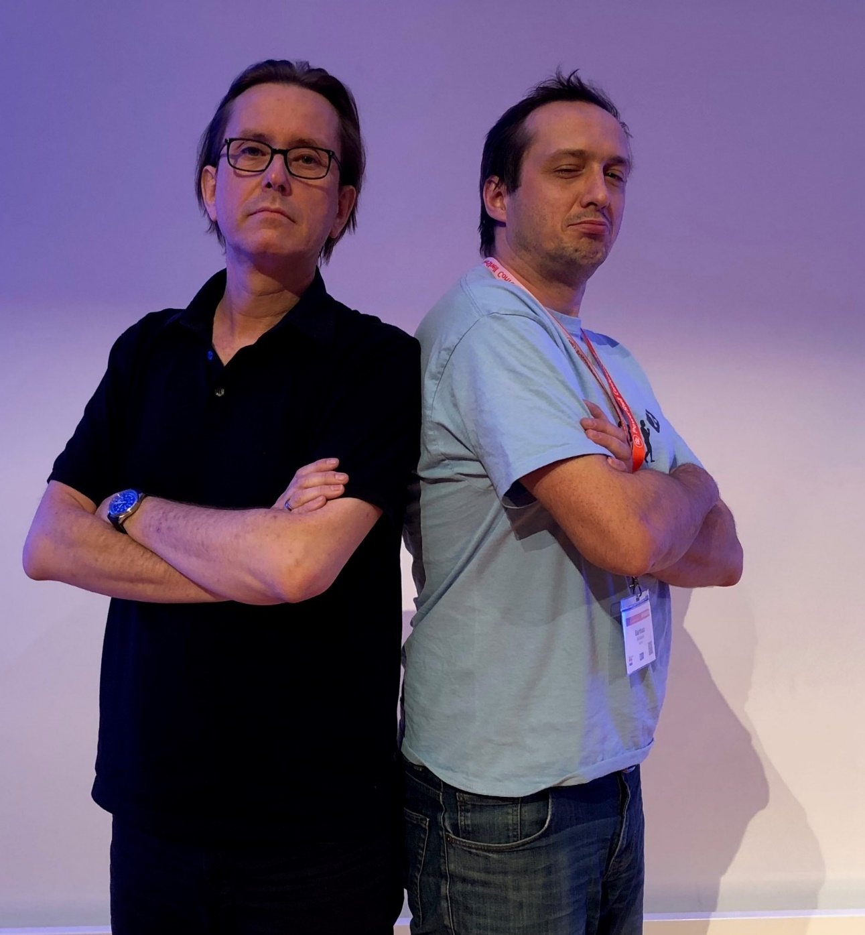

The perfect match?
First computer?
First (prof.) OS?
Favourite editor?
First computer?
First computer?
First (prof.) OS?
First computer?
First (prof.) OS?
Favourite editor?
Religion?

Slide 6
Get-Content
PowerShell Core 6
$isLinux = $true
PSRP interop
Win32-OpenSSH on Windows and *nix
Beyond the CLI: Universal Dashboard
DSC Core
Get-Content | more

Slide 7
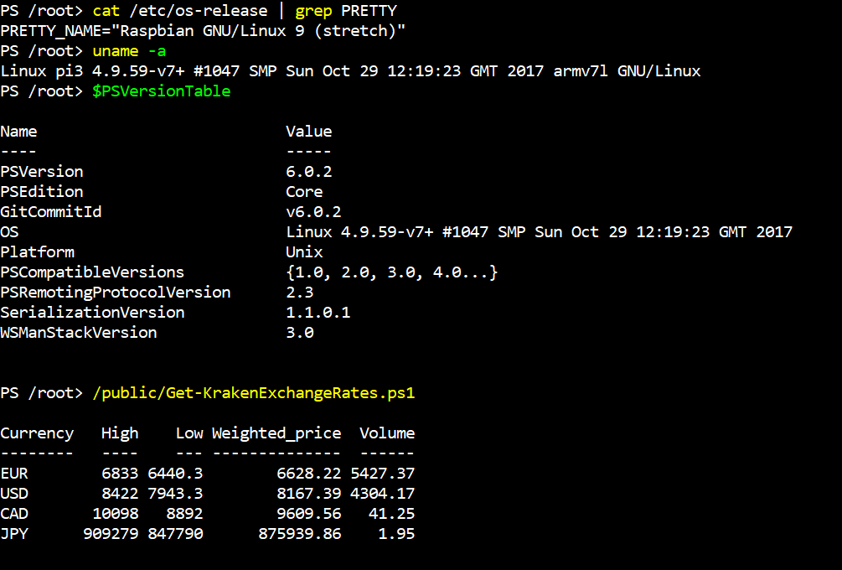
PoSh Core on RasPi
$uri = 'https://github.com/PowerShell/PowerShell/releases/download/
v6.0.1/powershell-6.0.1-linux-arm32.tar.gz'
apt-get install libunwind8
wget $uri mkdir /opt/powershell
tar -xvf ./powershell-6.0.1-linux-arm32.tar.gz -C /opt/powershell
ln -s /opt/powershell/pwsh /usr/bin/pwsh
Notes:
wget 'https://github.com/PowerShell/PowerShell/releases/
download/v6.0.2/powershell-6.0.2-linux-arm32.tar.gz'
apt-get install libunwind8
mkdir /opt/powershell
tar -xvf ./powershell-6.0.2-linux-arm32.tar.gz -C /opt/powershell
ln -s /opt/powershell/pwsh /usr/bin/pwsh

Slide 8
PoSh Core 6
1st version of PoSh Core: WS 2016 NANO
Support for Windows 7+
Support for LOTS of Linux distros/releases
Support for MaCOS 10.12+
Supports Unzip/Copy/Paste installations + multiple versions side-by-side
Comes with .NET Core 2.0 "attached", no sides effects on existing installations

Slide 9
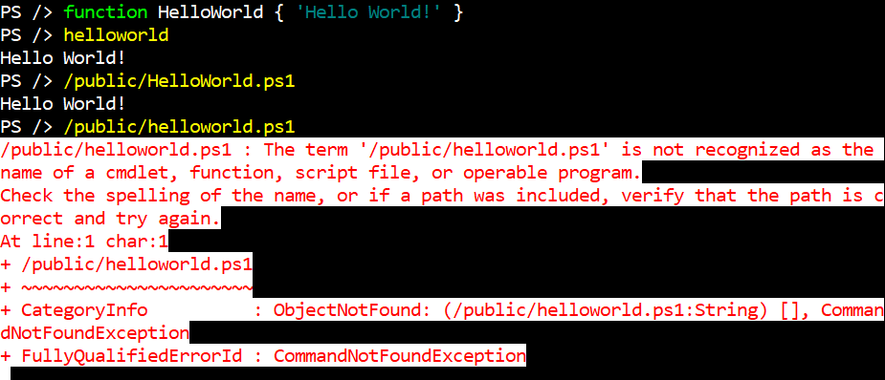
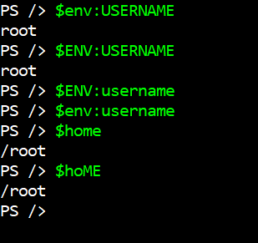
Mind the gap: Windows vs. *nix
"Same" CmdLets with different capabilites: Invoke-Command, ConvertTo-Json, ...
Less Built-In CmdLets
Missing aliases: ls, ps, wget, curl ...
NO RSAT for *nix
Case sensitivity
Notes:
Works:
$env:USERNAME
$ENV:USERNAME
Does not work:
$env:USERname
"cd" is both:
alias in PoSh
standard *nix command

Slide 10
Demo
Setup Win32-OpenSSH on Windows and Linux
Password less login
PowerShell Core on Linux: Strings vs. Objects

Slide 11
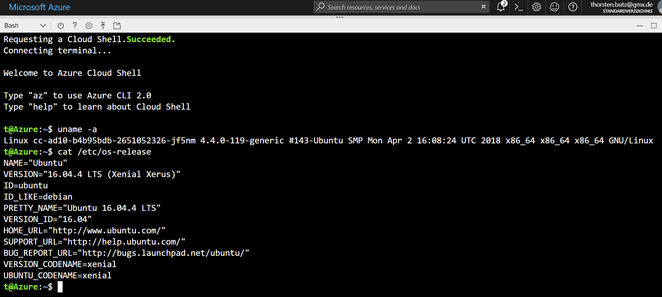
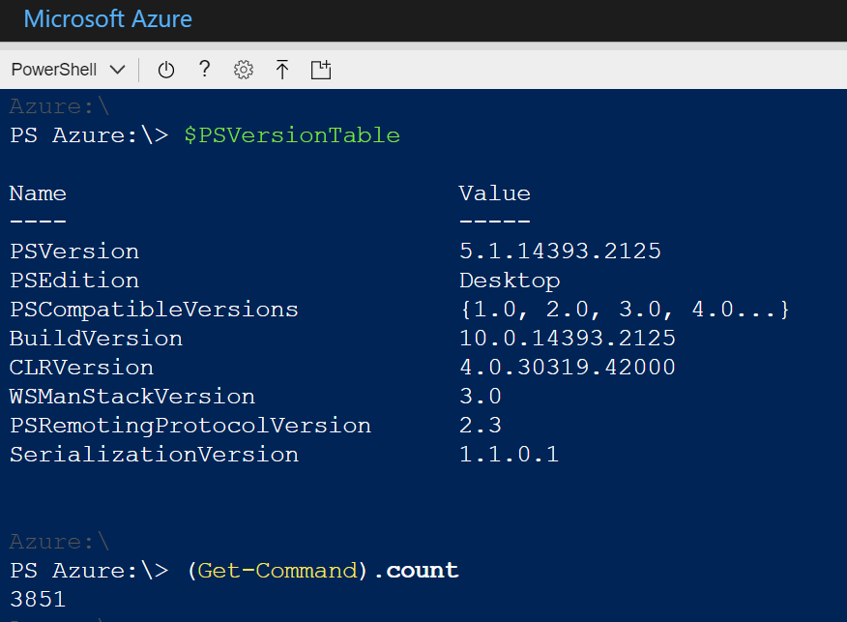
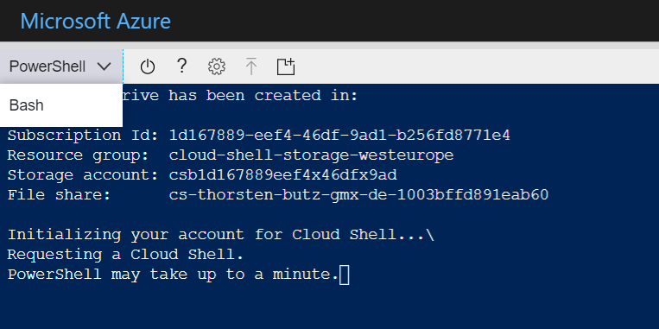
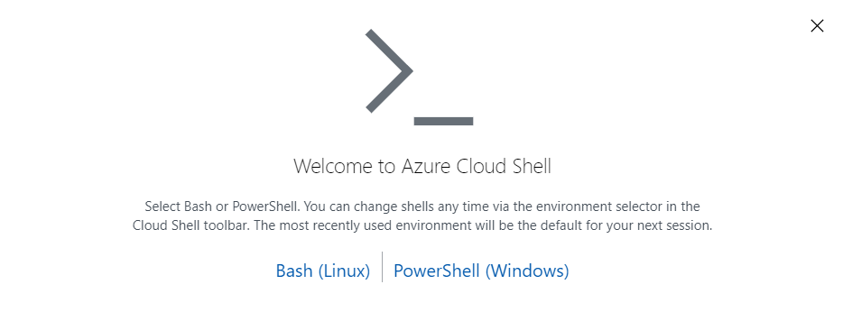
Azure Cloud Shell

Slide 12
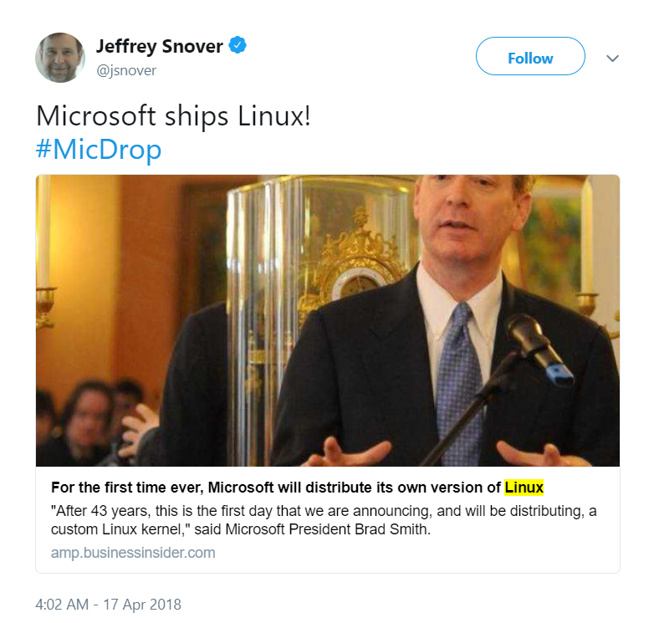
Azure Sphere (OS) for IoT devices
A new system for securing the tiny processors that power smart appliances, connected toys, and other gadgets.
Powered in large part by Linux,
Announced by Brad Smith * this (!) week
* Microsoft's president and chief legal officer
Notes:
"Microsoft * announced on Monday a new technology called Azure Sphere, a new system for securing the tiny processors that power smart appliances, connected toys, and other gadgets.
Azure Sphere is powered in large part by Linux, a free operating system that Microsoft once viewed as a major threat."
Announced by Brad Smith: Microsoft's president and chief legal officer
https://amp.businessinsider.com/microsoft-azure-sphere-is-powered-by-linux-2018-4

Slide 13
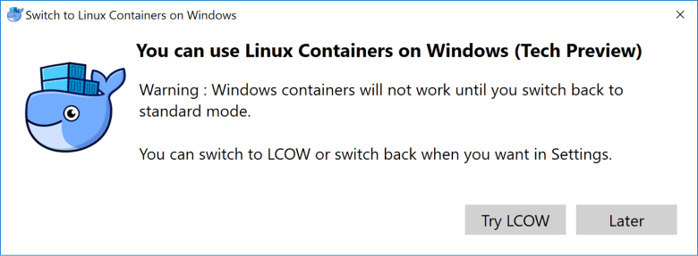
LinuxKit / LCOW
LinuxKit
A toolkit for building custom minimal, immutable Linux distributions
< 40 MB
LCOW
LinuxKit images and utilities for Microsoft's Linux Containers on Windows.
Requires Hyper-V Containers https://github.com/linuxkit/lcow
Notes:
https://stefanscherer.github.io/sneak-peek-at-lcow/
https://blog.docker.com/2017/11/docker-for-windows-17-11/
https://blog.docker.com/2017/12/top-5-blogs-2017-linuxkit-toolkit-building-secure-lean-portable-linux-subsystems/

Slide 14
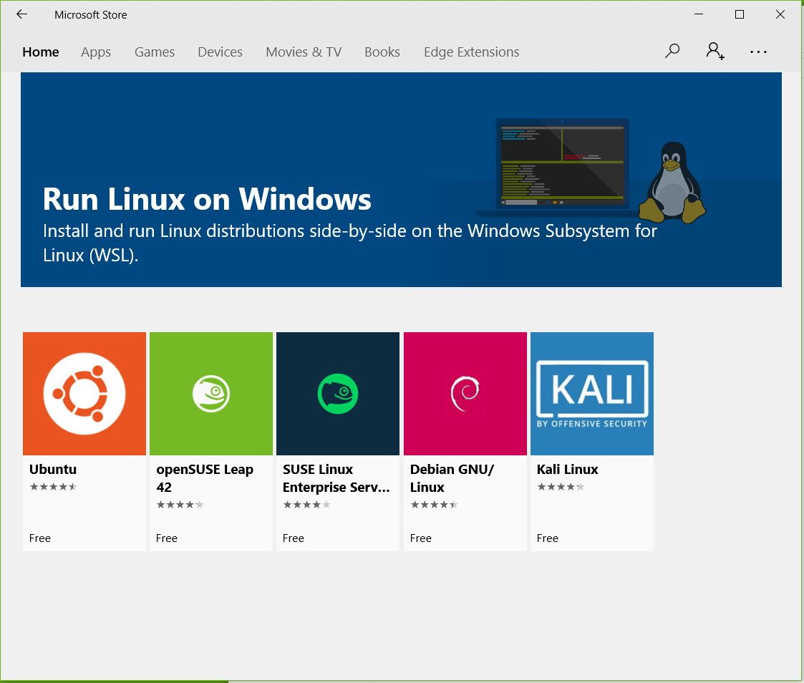
Skip this, you know it already …

Slide 15
Wrap up!
PoSh + Win32_OpenSSH
partially BETA quality
rapid deployment
community driven
$isConfusing = $true
Notes:
Joey Aiello about PowerShell 6
"I really dont see it as Microsoft's product anymore, this is very much a community OpenSoure project
that all of us are working on. "
May MeetUp with Joey Aiello: PowerShell 6 and OpenSSH (Mai 2017)
https://www.youtube.com/watch?v=Pa3P6gFEc6I

Slide 16
Wrap up!
about_pwsh "I really don't see it as Microsoft's product anymore,
this is very much a community OpenSoure project that all of us are working on."
Joey Aiello
Notes:
Joey Aiello about PowerShell 6
"I really dont see it as Microsoft's product anymore, this is very much a community OpenSoure project
that all of us are working on. "
May MeetUp with Joey Aiello: PowerShell 6 and OpenSSH (Mai 2017)
https://www.youtube.com/watch?v=Pa3P6gFEc6I

Slide 17
Receive-Questions -fromAudience

Slide 18
Enjoy-PSConfEU

Slide 19
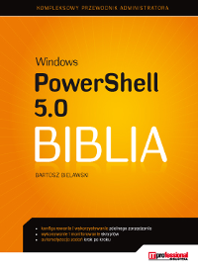
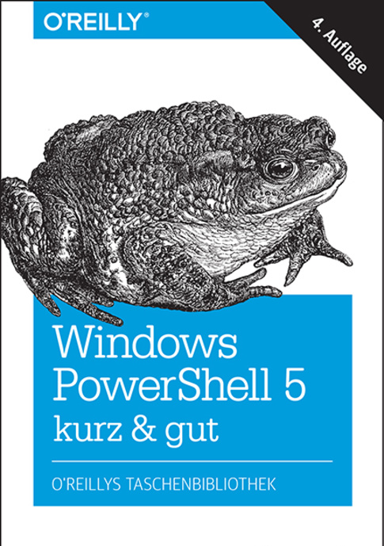
about_Speakers
Bartek Bielawski @bielawb Optiver
Thorsten Butz @thorstenbutz thorsten-butz.de

